Slide 1
Computer Architecture 1
Computer Organization and Design T H E H A R D W A R E / S O F T W A R E I N T E R F A C E
[Adapted from Computer Organization and Design, RISC-V Edition, Patterson & Hennessy, © 2018, MK] [Adapted from Great ideas in Computer Architecture (CS 61C) lecture slides, Garcia and Nikolíc, © 2020, UC Berkeley]

Slide 2







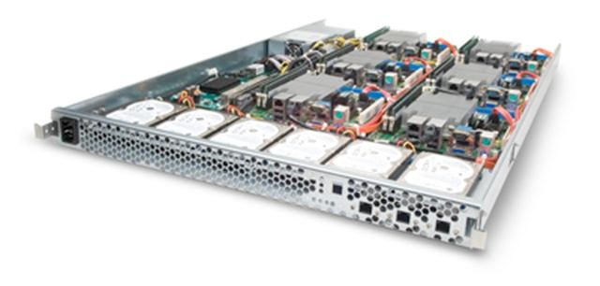




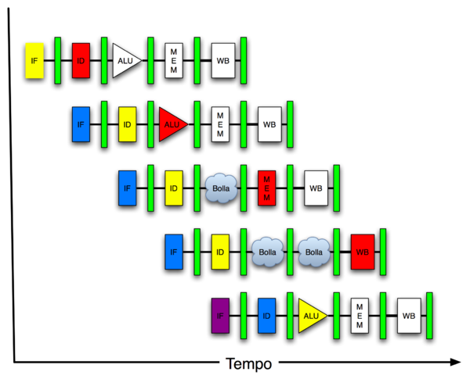

New-School Machine Structures
Harness Parallelism & achieve high performance
Software
Hardware
Parallel Requests Assigned to computer e.g., Search Cats
Parallel Threads Assigned to core e.g., Lookup, Ads
Parallel Instructions >1 instruction @ one time e.g., 5 pipelined instructions
Parallel Data >1 data item @ one time e.g., Add of 4 pairs of words
Hardware descriptions All gates work in parallel at same time
Smart Phone
Warehouse
Scale Computer
Computer
Core (Cache)
Core Memory
Input/Output
Exec. Unit(s)
Functional Block(s)
A₁+B₁
A₀+B₀
Main Memory
Logic Gates
A B
C
Out = AB+CD
D

Slide 3
6 Great Ideas in Computer Architecture
Abstraction (Layers of Representation/Interpretation)
Moore’s Law
Principle of Locality/Memory Hierarchy
Parallelism
Performance Measurement & Improvement
Dependability via Redundancy
Garcia, Nikolić

Slide 4
Instruction Timing
clock
PC old
pc
pc+4
Instr. fetch old
instruction register out
ALU result
Instr. decode
old
Execute
old
Memory Access
old
^{t}MEM ^{t}WB
memory data
^{t}IF
^{t}ID
^{t}EX
IF | ID | EX | MEM | WB | Total
I-MEM | Reg Read | ALU | D-MEM | Reg W
200 ps | 100 ps | 200 ps | 200 ps | 100 ps | 800 ps

Slide 5
Instruction Timing
Instr | IF = 200ps | ID = 100ps | ALU = 200ps | MEM=200ps | WB = 100ps | Total
add | X | X | X |  | X | 600ps
beq | X | X | X |  |  | 500ps
jal | X | X | X |  | X | 600ps
lw | X | X | X | X | X | 800ps
sw | X | X | X | X |  | 700ps
Maximum clock frequency
f_{max} = 1/800ps = 1.25 GHz

Slide 6
Performance Measures
“Our” Single-cycle RISC-V CPU executes instructions at 1.25 GHz
1 instruction every 800 ps
Can we improve its performance?
What do we mean with this statement?
Not so obvious:
Quicker response time, so one job finishes faster?
More jobs per unit time (e.g. web server returning pages, spoken words recognized)?
Longer battery life?
Garcia, Nikolić
6

Slide 7


Transportation Analogy
 | Sports Car | Bus
Passenger Capacity | 2 | 50
Travel Speed | 200 mph | 50 mph
Gas Mileage | 5 mpg | 2 mpg
50 Mile trip (assume they return instantaneously)
 | Sports Car | Bus
Travel Time | 15 min | 60 min
Time for 100 passengers | 750 min (50 2-person trips) | 120 min (two 50-person trips)
Gallons per passenger | 5 gallons | 0.5 gallons

Slide 8
Computer Analogy
Transportation | Computer
Trip Time | Program execution time: e.g. time to update display
Time for 100 passengers | Throughput: e.g. number of server requests handled per hour
Gallons per passenger | Energy per task*: e.g. how many movies you can watch per battery charge or energy bill for datacenter
* Note:
Power is not a good measure, since low-power CPU might run for a long time to complete one task consuming more energy than faster computer running at higher power for a shorter time
Garcia, Nikolić
8
RISC-V (8)

Slide 9


Slide 10
“Iron Law” of Processor Performance
Time Program
Instructions Program
Cycles
Time Cycle
=
*
Instruction
*
CPI = Cycles Per Instruction
RISC-V (10)

Slide 11
Defining (Speed) Performance
Normally interested in reducing
Response time (aka execution time) – the time between the start and the completion of a task
Important to individual users
Thus, to maximize performance, need to minimize execution time
performance_{X} = 1 / execution_time_{X}
If X is n times faster than Y, then
performance_{X} execution_time_{Y}
-------------------- = --------------------- = n
performance_{Y} execution_time_{X}
Throughput – the total amount of work done in a given time
Important to data center managers
Decreasing response time almost always improves throughput
Notes:
Increasing performance requires decreasing execution time

Slide 12
Performance Factors
Want to distinguish elapsed time and the time spent on our task
CPU execution time (CPU time) – time the CPU spends working on a task
Does not include time waiting for I/O or running other programs
CPU execution time # CPU clock cycles
= x clock cycle time
for a program for a program
or
CPU execution time # CPU clock cycles for a program
= -------------------------------------------
for a program clock rate
Can improve performance by reducing either the length of the clock cycle or the number of clock cycles required for a program
Notes:
Many techniques that decrease the number of clock cycles also increase the clock cycle time

Slide 13
Review: Machine Clock Rate
Clock rate (MHz, GHz) is inverse of clock cycle time (clock period)
CC = 1 / CR
one clock period
10 nsec clock cycle => 100 MHz clock rate
5 nsec clock cycle => 200 MHz clock rate
2 nsec clock cycle => 500 MHz clock rate
1 nsec clock cycle => 1 GHz clock rate
500 psec clock cycle => 2 GHz clock rate
250 psec clock cycle => 4 GHz clock rate
200 psec clock cycle => 5 GHz clock rate
Notes:
A clock cycle is the basic unit of time to execute one operation/pipeline stage/etc.

Slide 14
Clock Cycles per Instruction
Not all instructions take the same amount of time to execute
One way to think about execution time is that it equals the number of instructions executed multiplied by the average time per instruction
# CPU clock cycles # Instructions Average clock cycles
= x
for a program for a program per instruction
Clock cycles per instruction (CPI) – the average number of clock cycles each instruction takes to execute
A way to compare two different implementations of the same ISA
 | CPI for this instruction class
 | A | B | C
CPI | 1 | 2 | 3

Slide 15
Effective CPI
Computing the overall effective CPI is done by looking at the different types of instructions and their individual cycle counts and averaging
n
Overall effective CPI = Σ (CPI_{i} x IC_{i})
i = 1
Where IC_{i} is the count (percentage) of the number of instructions of class i executed
CPI_{i} is the (average) number of clock cycles per instruction for that instruction class
n is the number of instruction classes
The overall effective CPI varies by instruction mix – a measure of the dynamic frequency of instructions across one or many programs

Slide 16
THE Performance Equation
Our basic performance equation is then
CPU time = Instruction_count x CPI x clock_cycle
or
Instruction_count x CPI
CPU time = -----------------------------------------------
clock_rate
These equations separate the three key factors that affect performance
Can measure the CPU execution time by running the program
The clock rate is usually given
Can measure overall instruction count by using profilers/ simulators without knowing all of the implementation details
CPI varies by instruction type and ISA implementation for which we must know the implementation details
Notes:
Note that instruction count is dynamic – i.e., its not the number of lines in the code, but THE NUMBER OF INSTRUCTIONS EXECUTED

Slide 17
A Simple Example
Op | Freq | CPI_{i} | Freq x CPI_{i}
ALU | 50% | 1
Load | 20% | 5
Store | 10% | 3
Branch | 20% | 2
 |  |  | Σ =
.5
1.0
.3
.4
.5
.4
.3
.4
.5
1.0
.3
.2
.25
1.0
.3
.4
2.2
1.6
2.0
1.95
How much faster would the machine be if a better data cache reduced the average load time to 2 cycles?
How does this compare with using branch prediction to shave a cycle off the branch time?
What if two ALU instructions could be executed at once?
CPU time new = 1.6 x IC x CC so 2.2/1.6 means 37.5% faster
CPU time new = 2.0 x IC x CC so 2.2/2.0 means 10% faster
CPU time new = 1.95 x IC x CC so 2.2/1.95 means 12.8% faster
Notes:
For lecture

Slide 18
Instructions per Program
Determined by
Task
Algorithm, e.g. O(N²) vs O(N)
Programming language
Compiler
Instruction Set Architecture (ISA)
RISC-V (11)

Slide 19
(Average) Clock Cycles per Instruction (CPI)
Determined by
ISA
Processor implementation (or microarchitecture)
E.g. for “our” single-cycle RISC-V design, CPI = 1
Complex instructions (e.g. strcpy), CPI >> 1
Superscalar processors, CPI < 1 (next lectures)
Garcia, Nikolić
12
RISC-V (12)

Slide 20
Time per Cycle (1/Frequency)
Determined by
Processor microarchitecture (determines critical path through logic gates)
Technology (e.g. 5nm versus 28nm)
Power budget (lower voltages reduce transistor speed)
Garcia, Nikolić
13
RISC-V (13)

Slide 21
Speed Tradeoff Example
For some task (e.g. image compression) …
 | Processor A | Processor B
# Instructions | 1 Million | 1.5 Million
Average CPI | 2.5 | 1
Clock rate f | 2.5 GHz | 2 GHz
Execution time | 1 ms | 0.75 ms
Processor B is faster for this task, despite executing more instructions and having a slower clock rate!
Garcia, Nikolić
14
RISC-V (14)

Slide 22
Determinates of CPU Performance
CPU time = Instruction_count x CPI x clock_cycle
 | Instruction_count | CPI | clock_cycle
Algorithm
Programming language
Compiler
ISA
Processor organization
Technology
X
X
X
X
X
X
X
X
X
X
X
X
Notes:
For lecture

Slide 23


Slide 24


Where Does Energy Go in CMOS?
Symbol (INV)
^{V}DD
Schematic
A
Out
A
Out
Charging capacitors (CV²)
Leakage
(30%)
(70%)
Garcia, Nikolić
RISC-V (24)

Slide 25
Energy per Task
Energy = Program
Instructions Energy Program * Instruction
Energy α Instructions * C Program Program
_{V}2
“Capacitance” depends on technology,
processor features
e.g. # of cores
Supply voltage,
e.g. 1V
Want to reduce capacitance and voltage to reduce energy/task
Garcia, Nikolić
RISC-V (25)

Slide 26
Energy Tradeoff Example
“Next-generation” processor
C (Moore’s Law):
Supply voltage, V_{sup}:
Energy consumption:
-15 %
-15 %
0 - (1-0.85³) = -39 %
Significantly improved energy efficiency thanks to
Moore’s Law AND
Reduced supply voltage
RISC-V (26)

Slide 27
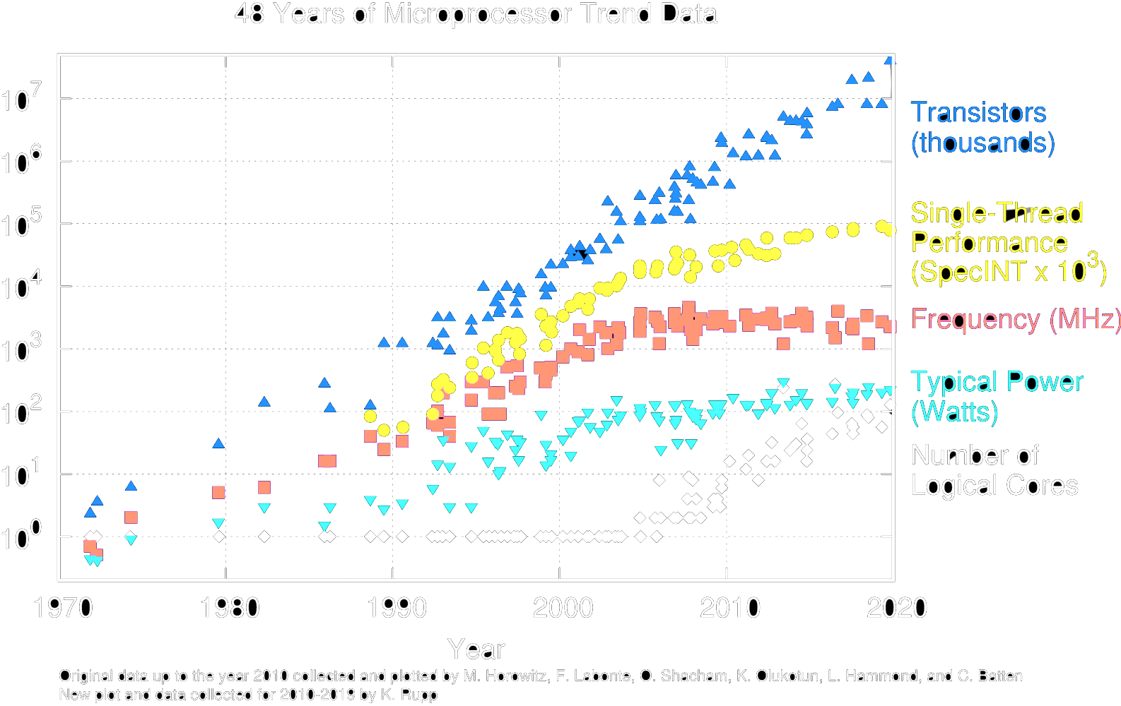
Performance/Power Trends
Garcia, Nikolić
RISC-V (27)

Slide 28
End of Scaling
In recent years, industry has not been able to reduce supply voltage much, as reducing it further would mean increasing “leakage power” where transistor switches don’t fully turn off (more like dimmer switch than on-off switch)
Also, size of transistors and hence capacitance, not shrinking as much as before between transistor generations
Need to go to 3D
Power becomes a growing concern – the “power wall”
RISC-V (28)

Slide 29
Energy “Iron Law”
Performance = Power *
(Tasks/Second) (Joules/Second)
Energy Efficiency
(Tasks/Joule)
Energy efficiency (e.g., instructions/Joule) is key metric in all computing devices
For power-constrained systems (e.g., 20MW datacenter), need better energy efficiency to get more performance at same power
For energy-constrained systems (e.g., 1W phone), need better energy efficiency to prolong battery life
RISC-V (21)

Slide 30


Slide 31
Gotta Do Laundry
Avi, Bora, Caroline, Dan each have one load of clothes to wash, dry, fold, and put away
Washer takes 30 minutes
Dryer takes 30 minutes
“Folder” takes 30 minutes
“Stasher” takes 30 minutes to put clothes into drawers
A B C D
Garcia, Nikolić
RISC-V (31)

Slide 32








Sequential Laundry
6 PM
7
8
9
10
11
12
1
2
30 30 30 30 30 30 30 30 30 30
Time
30 30 30 30 30 30
T
a s k
A
B
O
r d e r
C
D
Sequential laundry takes 8 hours for 4 loads!
RISC-V (32)

Slide 33








Pipelined Laundry
6 PM
7
8
9
10
T
a s k
30 30 30 30 30 30 30 30
Time
A
What happens sequentially?
What happens simultaneously?
B
O
r d e r
C
D
Pipelined laundry takes 3.5 hours for 4 loads!
Garcia, Nikolić
RISC-V (25)

Slide 34
Sequential Laundry
6 PM
7
8
9
10
30 30 30 30 30 30 30 30
Time
T
a s k
Pipelining doesn’t help latency of single task, it helps throughput of entire workload
Multiple tasks operating simultaneously using different resources
Potential speedup = Number of pipe stages
Time to “fill” pipeline and time to “drain” it reduces speedup:
2.3X v. 4X in this example
A
B
O
r d e r
C
D
Garcia, Nikolić
RISC-V (34)

Slide 35
Sequential Laundry
6 PM
7
8
9
10
Suppose:
new Washer takes 20 minutes
new Stasher takes 20 minutes.
T
a s k
30 30 30 30 30 30 30 30
Time
A
B
How much faster is pipeline?
O
r d e r
Pipeline rate limited by slowest pipeline stage
C
D
Unbalanced lengths of pipe stages reduce speedup
RISC-V (35)

Slide 36







‘Sequential’ RISC-V Datapath
Phase | Pictogram | t_{step} Serial
Instruction Fetch |  | 200 ps
Reg Read |  | 100 ps
ALU |  | 200 ps
Memory |  | 200 ps
Register Write |  | 100 ps
^{t}instruction |  | 800 ps
instruction sequence
^{t}instruction
^{t}instruction
^{t}instruction
add t0, t1, t2
or t3, t4, t5 sll t6, t0, t3
Garcia, Nikolić
29
RISC-V (29)

Slide 37

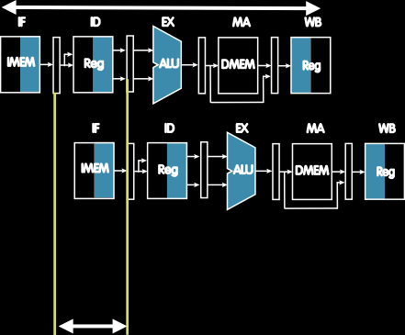

Pipelined RISC-V Datapath
Phase | Pictogram | t_{step} Serial |  | t_{cycle} Pipelined
Instruction Fetch |  | 200 ps |  | 200 ps
Reg Read |  | 100 ps |  | 200 ps
ALU |  | 200 ps |  | 200 ps
Memory |  | 200 ps |  | 200 ps
Register Write |  | 100 ps |  | 200 ps
^{t}instruction |  | 800 ps |  | 1000 ps
instruction sequence
^{t}instruction
add t0, t1, t2
or t3, t4, t5 sll t6, t0, t3
^{t}cycle ^{t}cycle
^{t}cycle ^{t}cycle
Garcia, Nikolić
30
RISC-V (30)

Slide 38
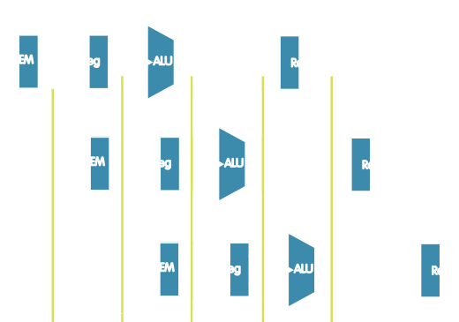
Pipelined RISC-V Datapath
instruction sequence
add t0, t1, t2
or t3, t4, t5 sll t6, t0, t3
^{t}cycle ^{t}cycle ^{t}cycle ^{t}cycle
 | Single Cycle | Pipelined
Timing | t_{step} = 100 … 200 ps | t_{cycle} = 200 ps
 | Register access only 100 ps | All cycles same length
Instruction time, t_{instruction} | = t_{cycle} = 800 ps | 1000 ps
CPI (Cycles Per Instruction) | ~1 (ideal) | ~1 (ideal), <1 (actual)
Clock rate, f_{s} | 1/800 ps = 1.25 GHz | 1/200 ps = 5 GHz
Relative speed | 1 x | 4 x
RISC-V (31)

Slide 39


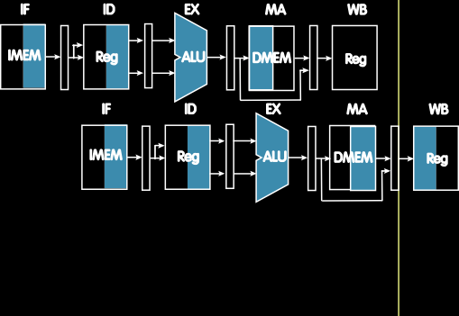
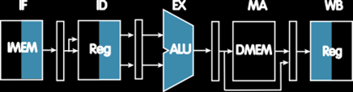
Sequential vs. Simultaneous
What happens sequentially and what simultaneously?
^{t}instruction ^{= 1000ps}
add t0, t1, t2
or t3, t4, t5
sll t6, t0, t3 sw t0, 4(t3) lw t0, 8(t3)
instruction sequence
addi t2, t2, 1
^{t}cycle
RISC-V (32)

Slide 40

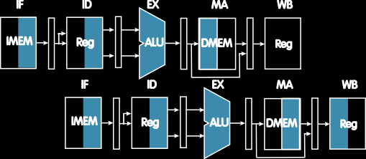

Sequential vs. Simultaneous
What happens sequentially and what simultaneously?
^{t}instruction ^{= 1000ps}
Resource use in a
particular time slot
add t0, t1, t2
Resource use of instruction over time
or t3, t4, t5
instruction sequence
sll t6, t0, t3
sw t0, 4(t3) lw t0, 8(t3)
addi t2, t2, 1
^{t}cycle
Garcia, Nikolić
RISC-V (33)

Slide 41


Slide 42



Single-Cycle RV32I Datapath
+4
Add
pc+4
DataD
R[rs1]
2
0
Inst[11:7]
alu
1
PC
addr
AddrD
1
DataB addr
0
1
pc
inst
Inst[19:15]
AddrA AddrB
DataA
Inst[24:20]
Branch Comp
0
ALU
mem
clk
DataB
0
1
IMEM
Reg [ ]
DMEM
Inst
clk
Imm. Gen
R[rs2]
clk
[31:20]
Imm[31:0]
PCSel
Inst[31:0]
ImmSel RegWEn
BrUn
BrLT ^{Bsel Asel} ALUSel
MemRW
WBSel
Control logic
BrEq
Garcia, Nikolić
RISC-V (35)

Slide 43
Single-Cycle RV32I Datapath
+4
Add
pc+4
DataD
R[rs1]
2
0
Inst[11:7]
AddrD AddrA
AddrB
alu
1
PC
addr
inst
Inst[19:15]
1
DataB addr
0
1
pc
DataA
Inst[24:20]
Branch Comp
0
ALU
mem
clk
DataB
0
1
IMEM
Inst [31:20]
Reg [ ]
DMEM
clk
Imm.
R[rs2]
clk
Write Back
Gen
Imm[31:0]
Instruction Fetch (IF)
InstructionDecode/ Register Read
(ID)
ALU Execute (EX)
Memory
Access (WB) (MA)
RISC-V (36)

Slide 44







Pipelined RV32I Datapath
Recalculate PC+4 in M stage to avoid sending both PC and PC+4 down pipeline
+4
pc_{EX}
+4 _{Add}
Add
pc_{ID}
pc_{MA} alu_{MA}
pc+4
DataD
rs1
2
EX
0
1
PC
addr
inst
AddrD
1
0
1
pc
AddrA AddrB
DataA
DataB
Branch Comp
0
ALU
mem
inst
DataB
addr
clk
iD
0
1
Write Back
IMEM
Reg [ ]
DMEM
clk
rs2_{EX}
rs2_{MA}
clk
_{Imm.} Imm[31:0]
Gen
inst_{EX}
inst_{MA}
inst_{WB}
IF/ID ID/EX
EX/MA
MA/WB
Must pipeline instruction along with data, so control operates correctly in each stage
RISC-V (37)

Slide 45
Pipelined RV32I Datapath
+4
pc_{EX}
+4 _{Add}
Add
pc_{ID}
pc_{MA} alu_{MA}
pc+4
DataD
rs1
2
EX
0
1
PC
addr
inst
AddrD
1
0
1
pc
AddrA AddrB
DataA
DataB
Branch Comp
0
ALU
mem
inst
DataB
addr
clk
iD
0
1
Write Back
IMEM
Reg [ ]
DMEM
clk
rs2_{EX}
rs2_{MA}
clk
_{Imm.} Imm[31:0]
Gen
inst_{EX}
slt t6,t0,t3
inst_{MA}
inst_{WB}
lw t0,8(t3) sw t0,4(t3)
or t3,t4,t5
Pipeline registers separate stages, hold data for each instruction in flight
Garcia, Nikolić
RISC-V (38)

Slide 46





Pipelined Control
Control signals derived from instruction
As in single-cycle implementation
Information is stored in pipeline registers for use by later stages
instruction
WB
WB
MA
Control
MA
WB
EX
IF/ID
ID/EX
EX/MA
MA/WB
RISC-V (39)

Slide 47


Slide 48




Hazards Ahead!
Garcia, Nikolić
RISC-V (41)

Slide 49
Pipelining Hazards
A hazard is a situation that prevents starting the next instruction in the next clock cycle
Structural hazard
A required resource is busy (e.g. needed in multiple stages)
Data hazard
Data dependency between instructions
Need to wait for previous instruction to complete its data read/write
Control hazard
Flow of execution depends on previous instruction
Garcia, Nikolić
42
RISC-V (42)

Slide 50
Structural Hazard
Problem: Two or more instructions in the pipeline compete for access to a single physical resource
Solution 1: Instructions take it in turns to use resource, some instructions have to stall
Solution 2: Add more hardware to machine
Can always solve a structural hazard by adding more hardware
Garcia, Nikolić
43
RISC-V (43)

Slide 51
Regfile Structural Hazards
Each instruction:
Can read up to two operands in decode stage
Can write one value in writeback stage
Avoid structural hazard by having separate “ports”
Two independent read ports and one independent write port
Three accesses per cycle can happen simultaneously
Garcia, Nikolić
44

Slide 52


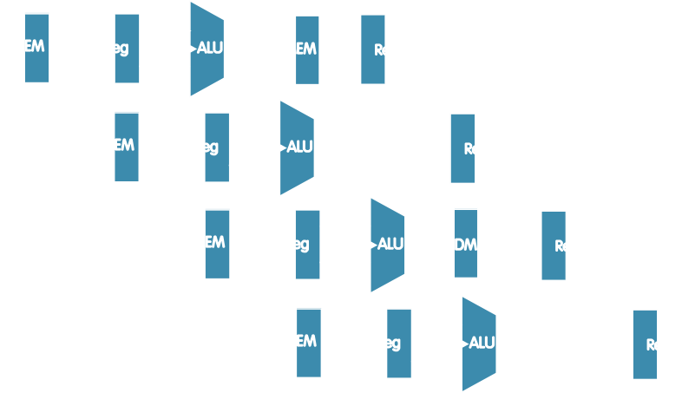
Structural Hazard: Memory Access
Instruction and data memory used simultaneously
Use two separate memories
add t0, t1, t2
instruction sequence
lw t0, 8(t3)
slt t6, t0, t3
sw t0, 4(t3) addi t0, t1, t2
Garcia, Nikolić

Slide 53


Instruction and Data Caches
Fast, on-chip memory, separate for instructions and data
Processor Memory
Control
Program
Datapath
Instruction Cache
 | Registers
Bytes
Data Cache
Data
Arithmetic-Logic Unit (ALU)
Garcia, Nikolić

Slide 54
Structural Hazards – Summary
Conflict for use of a resource
In RISC-V pipeline with a single memory
Load/store requires data access
Without separate memories, instruction fetch would have to stall for that cycle
All other operations in pipeline would have to wait
Pipelined datapaths require separate instruction/data memories
Or separate instruction/data caches
RISC ISAs (including RISC-V) designed to avoid structural hazards
e.g. at most one memory access/instruction
Garcia, Nikolić
47
RISC-V (47)

Slide 55


Slide 56


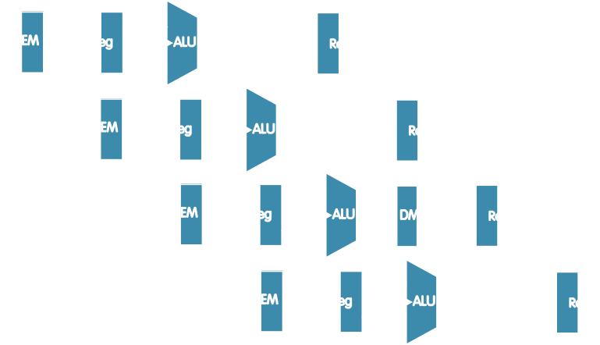

Data Hazard: Register Access
Separate ports, but what if write to same register as read?
Does sw in the example fetch the old or new value?
add t0, t1, t2
instruction sequence
or t3, t4, t5
slt t6, t0, t3
sw t0, 4(t3) addi t0, t1, t2
Garcia, Nikolić
RISC-V (49)

Slide 57




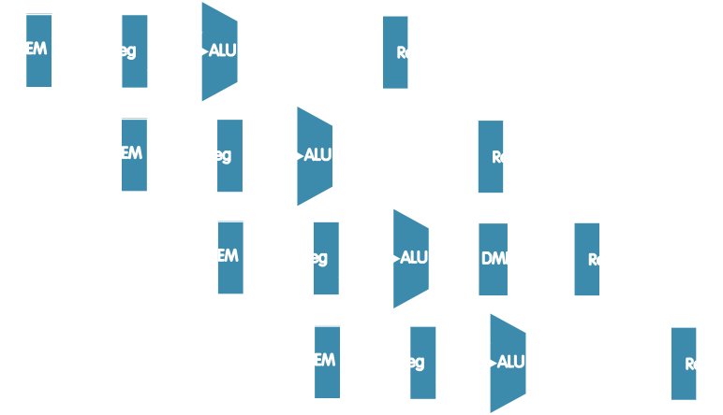

Data Hazard: Register Access
Exploit high speed of register file (100 ps)
WB updates value
ID reads new value
Indicated in diagram by shading
add t0, t1, t2
instruction sequence
or t3, t4, t5
slt t6, t0, t3
sw t0, 4(t3) addi t0, t1, t2
Might not always be possible to write then read in same cycle, especially in high-frequency designs. Check assumptions in Garcia, Nikolić
any question.
RISC-V (50)

Slide 58

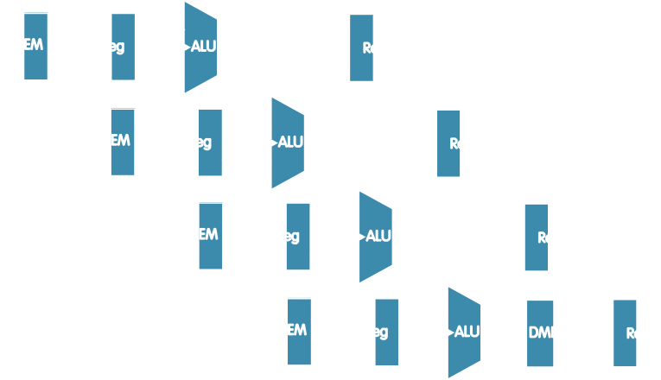
Data Hazard: ALU Result
5 | 5 | 5 | 5 | 5/9 | 9 | 9 | 9 | 9
Value of s0
add s0,t0,t1 sub t2,s0,t0
or t6,s0,t3
xor t5,t1,s0 sw s0,8(t3)
Without some fix, sub and or will calculate wrong result!
instruction sequence
RISC-V (51)

Slide 59
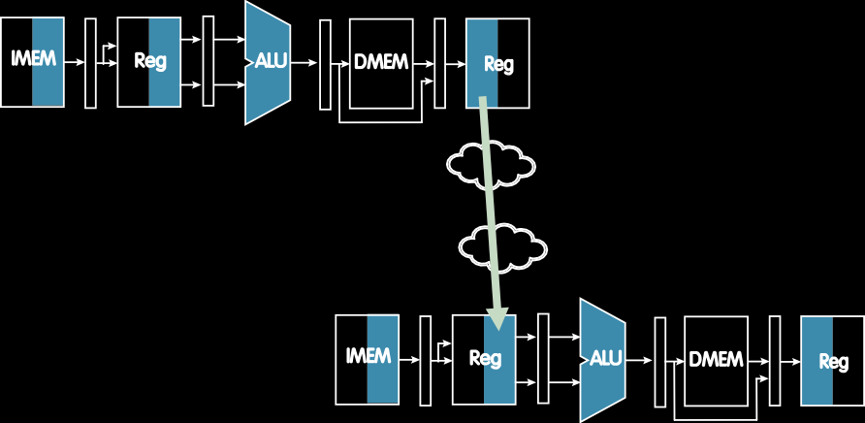

Solution 1: Stalling
Problem: Instruction depends on result from previous instruction
 | add | s0, | t0, | t1
add | sub s0, | t2, t0, | s0, t1 | t3
“bubbles”
sub t2, s0, t3
Bubble:
Effectively nop: Affected pipeline stages do “nothing”
Garcia, Nikolić
RISC-V (52)

Slide 60
Stalls and Performance
Stalls reduce performance
But stalls are required to get correct results
Compiler can arrange code or insert nops (addi x0, x0, 0) to avoid hazards and stalls
Requires knowledge of the pipeline structure
Garcia, Nikolić
53
RISC-V (53)

Slide 61
Forwarding
add s0, t0, t1
instruction sequence
sub t2, s0, t0
or t6, s0, t3
xor t5, t1,s0 sw s0, 8(t3)

Slide 62
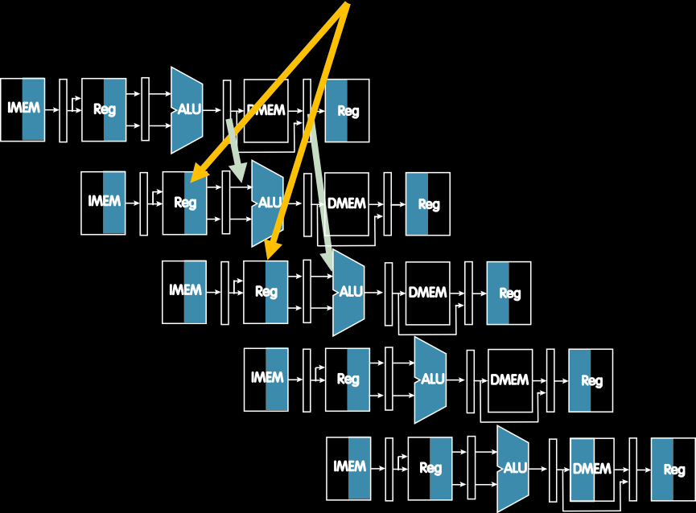
Solution 2: Forwarding
5 | 5 | 5 | 5 | 5/9 | 9 | 9 | 9 | 9
instruction sequence
Value of s0
add s0,t0,t1 sub t2,s0,t0
or t6,s0,t3
xor t5,t1,s0 sw s0,8(t3)
Forwarding: grab operand from pipeline stage,
rather than register file
Garcia, Nikolić

Slide 63
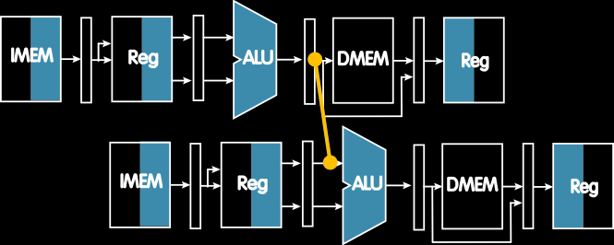
Forwarding (aka Bypassing)
Use result when it is computed
Don’t wait for it to be stored in a register
Requires extra connections in the datapath
add s0, t0, t1 sub t2, s0, t3
Garcia, Nikolić

Slide 64
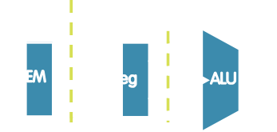

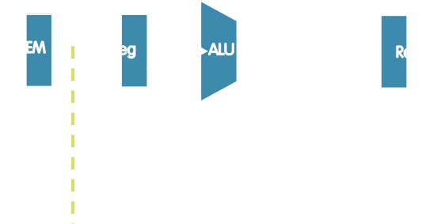

Data Needed for Forwarding (Example)
Compare destination of older instructions in pipeline with sources of new instruction in decode stage.
Must ignore writes to x0!
^{IF ID} inst_{X}.rd ^{A WB}
add t0, t0, t1
EX M
inst_{D}.rs1
sub t3, t0, t5
sub t6, t0, t3
Garcia, Nikolić

Slide 65

Pipelined RV32I Datapath
+4 _{Add}
+4 _{Add}
DataD
AddrD AddrA
AddrB
PC
addr
DataB addr
inst
DataA
Branch
ALU
DataB
Comp
clk
IMEM
Reg [ ]
DMEM
clk
clk
Imm. Gen
Remember to forward operand B as well!
Forwarding control logic

Slide 66

Data Hazard and Forwarding
Value of s0
add s0,t0,t1
sub t2,s0,t0
or t6,s0,t3
xor t5,t1,s0
sw s0,8(t3)
Forwarding: grab operand from pipeline stage, rather than register file
5 | 5 | 5 | 5 | 5/9 | 9 | 9 | 9 | 9
instruction sequence
RISC-V (59)

Slide 67
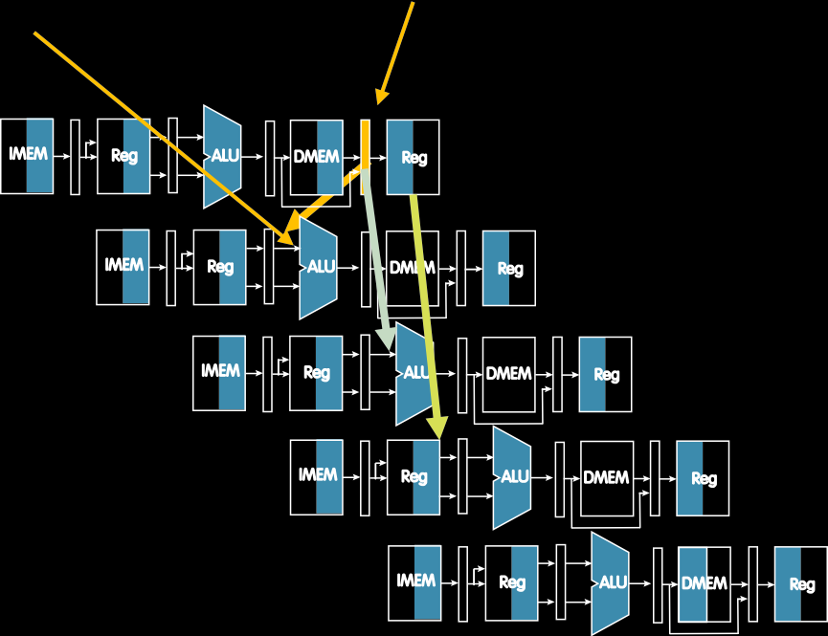
Load Data Hazard
Needs to be here!
Data from memory is here
1 -cycle stall unavoidable!
Forward
lw s2,20(s1)
instruction sequence
and s4,s2,s5
Unaffected
or s8,s2,s6
add s9,s4,s2
slt s1,s6,s7
Load requires one-cycle pipeline stall
RISC-V (60)

Slide 68
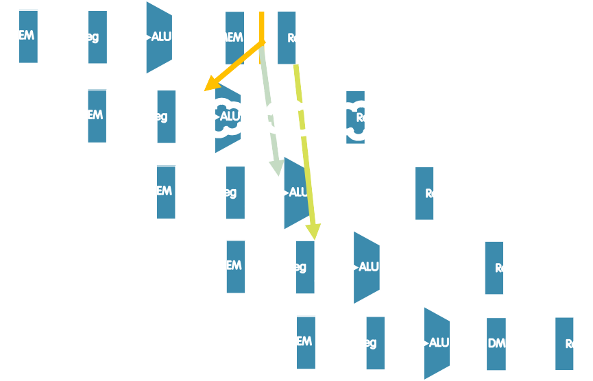
Stall Pipeline
lw s2,20(s1)
instruction sequence
Stall
Repeat and and forward
and s4, s2, s5
nop
or s8,s2,s6
add s9,s4,s2
slt s1,s6,s7
Load requires one-cycle pipeline stall
RISC-V (61)

Slide 69
lw Data Hazard
Slot after a load is called a load delay slot
If that instruction uses the result of the load, then the hardware will stall for one cycle
Equivalent to inserting an explicit nop in the slot
except the latter uses more code space
Performance loss
Idea:
Put unrelated instruction into load delay slot
No performance loss!
RISC-V (62)

Slide 70
Code Scheduling to Avoid Stalls
Reorder code to avoid use of load result in the next instr!
RISC-V code for A[3]=A[0]+A[1]; A[4]=A[0]+A[2]
Original Order:
Alternative:
lw t1, 0(t0) lw t2, 4(t0) add t3, t1, t2 sw t3, 12(t0) lw t4, 8(t0) add t5, t1, t4 sw t5, 16(t0)
lw t1, 0(t0) lw t2, 4(t0) lw t4, 8(t0) add t3, t1, t2 sw t3, 12(t0) add t5, t1, t4 sw t5, 16(t0)
7 cycles
Stall!
9 cycles
Stall!
RISC-V (63)

Slide 71


Slide 72
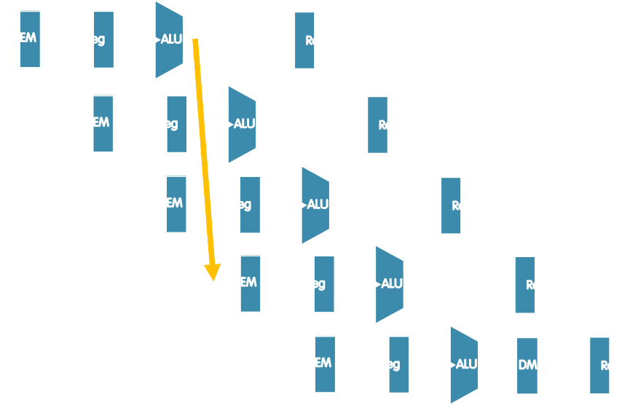
Control Hazards
Executed regardless of branch outcome!
Executed regardless o branch outcome!
beq t0,t1,Label
sub t2,s0,t0
or t6,s0,t3
PC
updated
xor t5,t1,s0
sw s0,8(t3)
Two stall cycles after a branch!
RISC-V (65)

Slide 73
Observation
If branch not taken, then instructions fetched sequentially after branch are correct
If branch or jump taken, then need to flush incorrect instructions from pipeline by converting to NOPs
RISC-V (66)

Slide 74
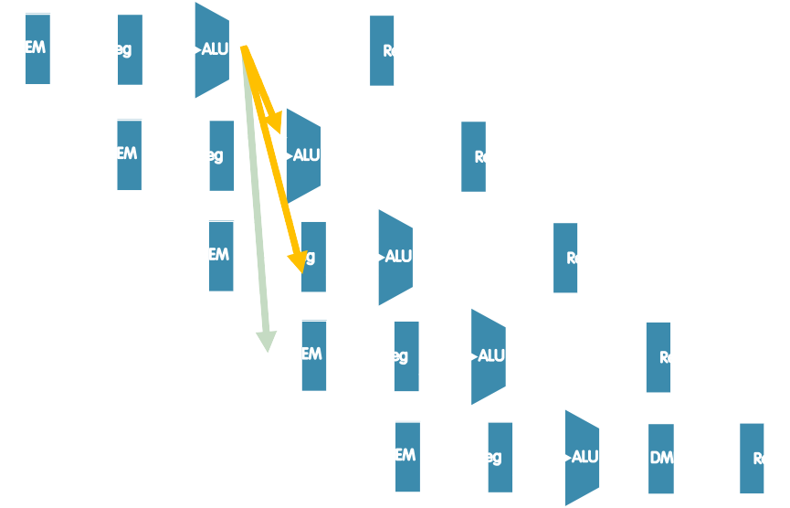
Kill Instructions after Branch if Taken
beq t0,t1,Label
Taken branch!
sub t2,s0,t0
Convert to nop
or t6,s0,t3
Convert to nop
PC
updated
Label: xor t5,t1,s0
RISC-V (67)

Slide 75
Reducing Branch Penalties
Every taken branch in simple pipeline costs 2 dead cycles
To improve performance, use “branch prediction” to guess which way branch will go earlier in pipeline
Only flush pipeline if branch prediction was incorrect
RISC-V (68)

Slide 76
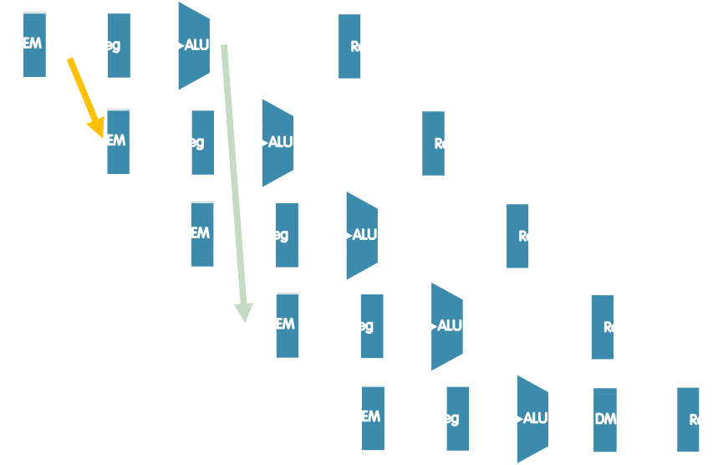
Branch Prediction
beq t0,t1,Label
Taken branch!
Label :…
Guess next PC!
Check guess
RISC-V (69)

Slide 77


Slide 78
Increasing Processor Performance
Clock rate
Limited by technology and power dissipation
Pipelining
“Overlap” instruction execution
Deeper pipeline: 5 => 10 => 15 stages
Less work per stage → shorter clock cycle
But more potential for hazards (CPI > 1)
Multi-issue “superscalar” processor

Slide 79
Superscalar Processor
Multiple issue “superscalar”
Replicate pipeline stages ⇒ multiple pipelines
Start multiple instructions per clock cycle
CPI < 1, so use Instructions Per Cycle (IPC)
E.g., 4GHz 4-way multiple-issue
16 BIPS, peak CPI = 0.25, peak IPC = 4
Dependencies reduce this in practice
“Out-of-Order” execution
Reorder instructions dynamically in hardware to reduce impact of hazards
CS152 discusses these techniques!

Slide 80
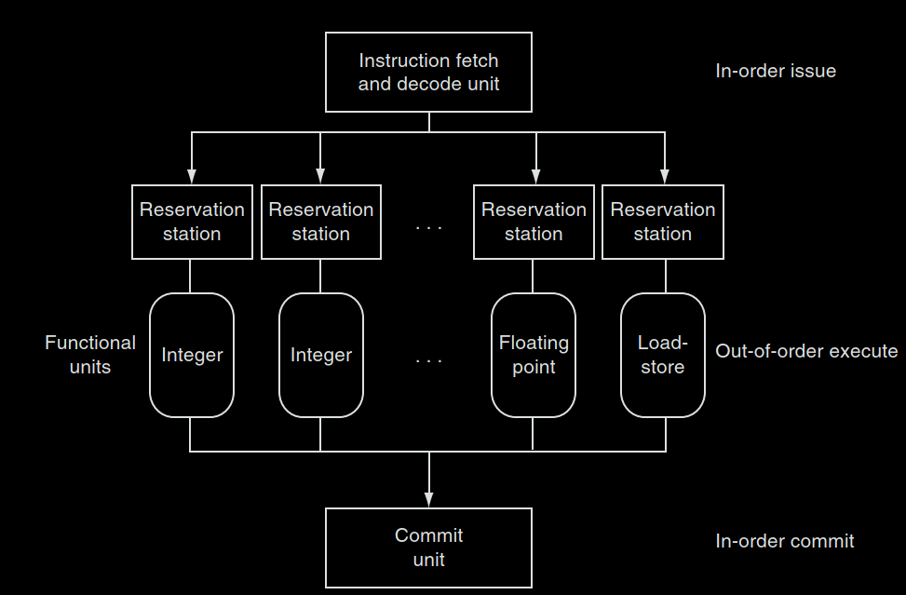
Superscalar Processor
P&H, p.330

Slide 81
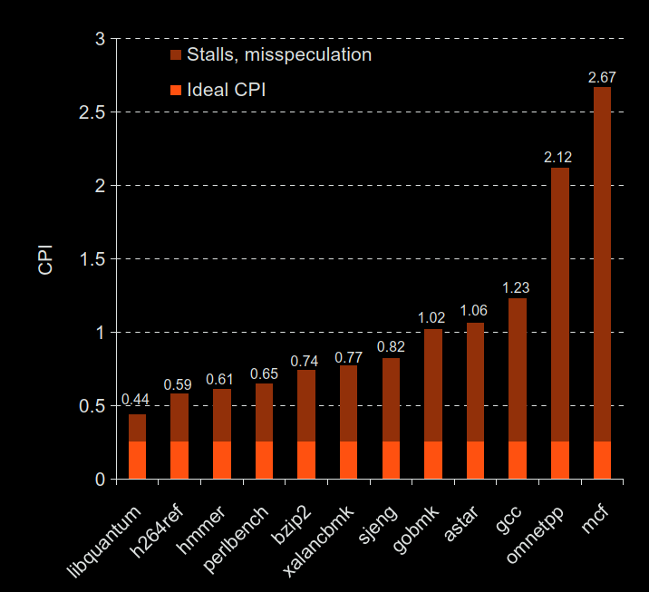
Benchmark: CPI of i7
CPI = 1
P&H, p.330

Slide 82
“Iron Law” of Processor Performance
CPI = Cycles Per Instruction
Can time
Can count
Can look up
Instructions×
× Time
Time = Program
Cycles
Program
Instruction
Cycle
Time _{÷ (}Instructions × Time ₎
_{CPI =} Cycles =
Instruction Program Program Cycle

Slide 83
Pipelining and ISA Design
RISC-V ISA designed for pipelining
All instructions are 32-bits
Easy to fetch and decode in one cycle
Versus x86: 1- to 15-byte instructions
Few and regular instruction formats
Decode and read registers in one step
Load/store addressing
Calculate address in 3rd stage, access memory in 4th stage
Alignment of memory operands
Memory access takes only one cycle

Slide 84
“And In conclusion…”
We have built a processor!
Capable of executing all RISC-V instructions in one cycle each
5 Phases of execution
IF, ID, EX, MEM, WB
Not all instructions are active in all phases
Controller specifies how to execute instructions
Implemented as ROM or logic
Pipelining improves performance
But we must resolve hazards

